Slide 1

Computer Organization 2
Lab tutorial 4
Chapter (4)

Slide 2
Agenda [ CH(4) Register Transfer and Microoperations ]
Register Transfer Language
Register Transfer
Bus and Memory Transfer
Arithmetic Microoperations
Logic Microoperations
Shift Microoperations
Arithmetic Logic Shift Unit

Slide 3
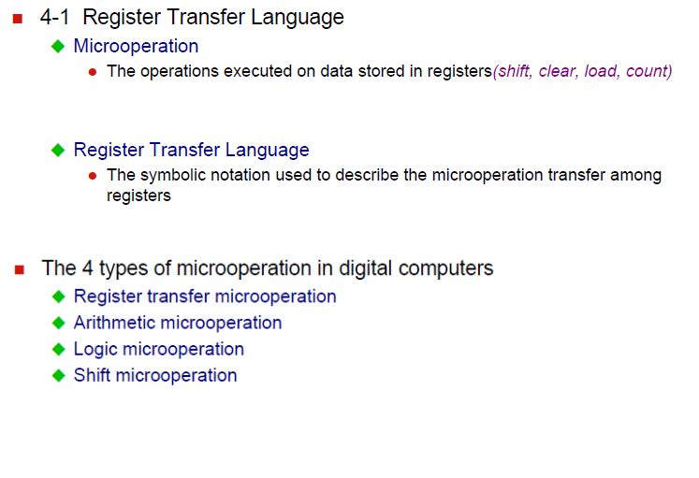
4-1 Register Transfer Language

Slide 4
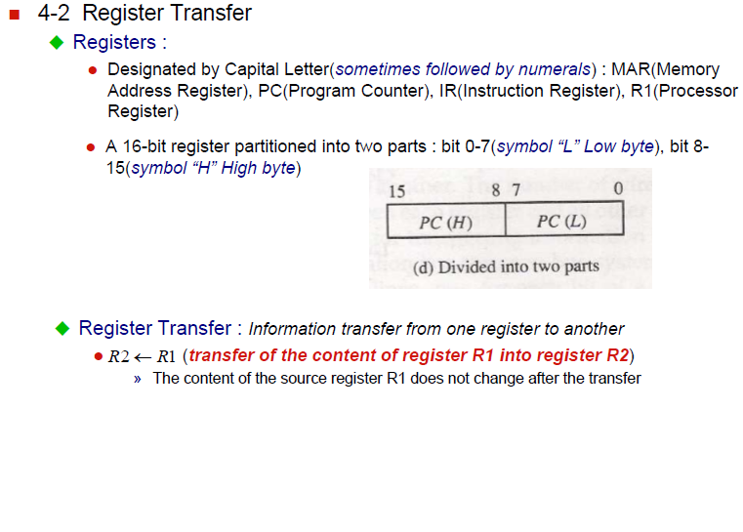
4-2 Register Transfer

Slide 5
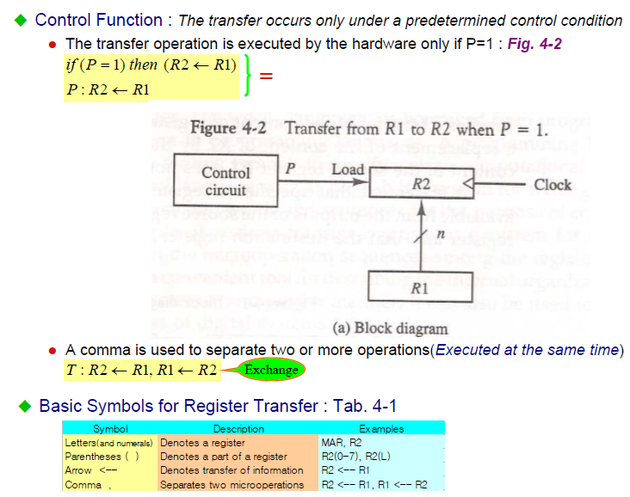
4-2 Register Transfer

Slide 6
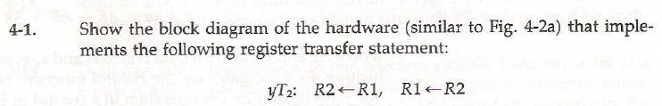
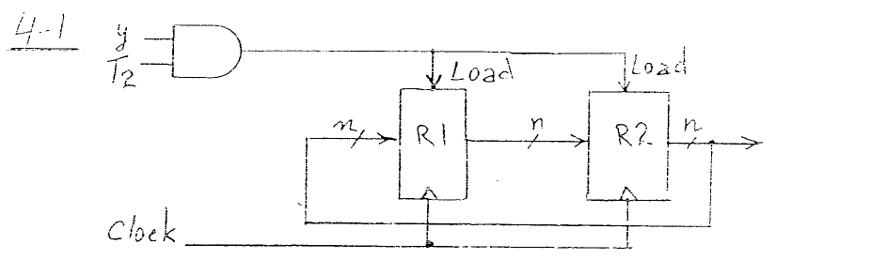
Problem

Slide 7
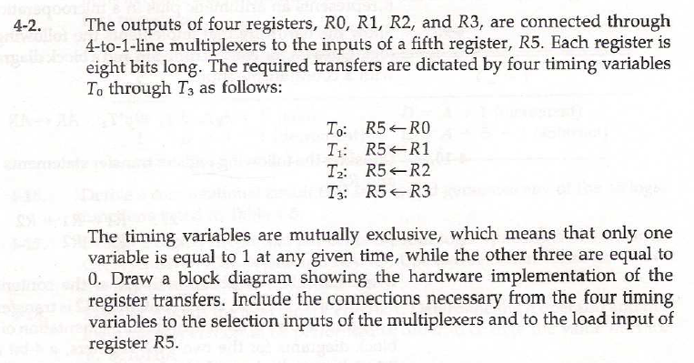
Problem

Slide 8
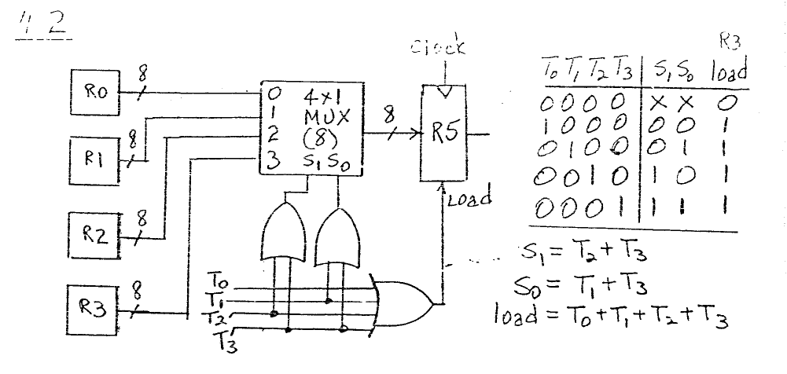
Problem

Slide 9
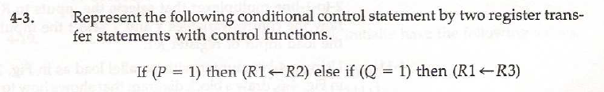
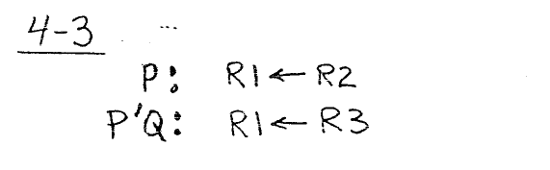
Problem

Slide 10
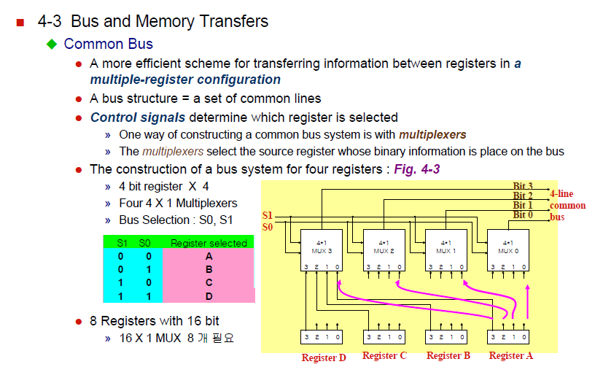
4-3 Bus and Memory Transfer

Slide 11
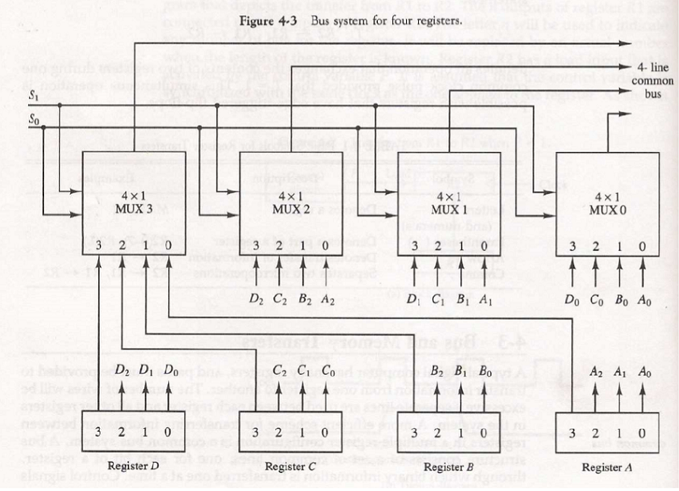
4-3 Bus and Memory Transfer

Slide 12
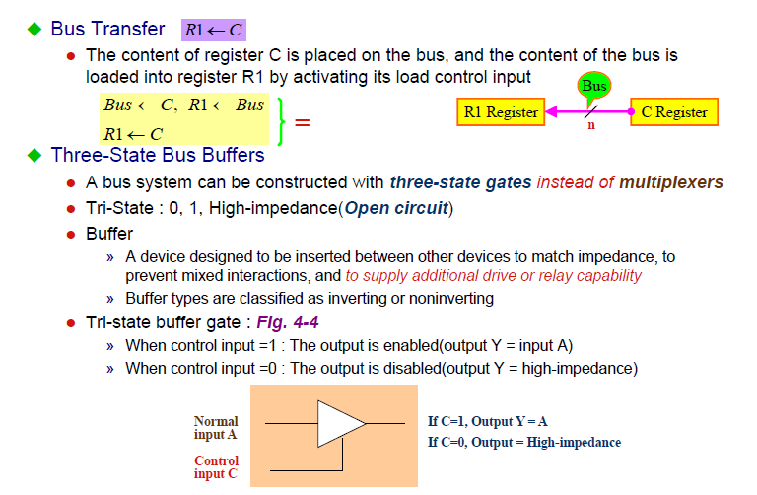
4-3 Bus and Memory Transfer

Slide 13
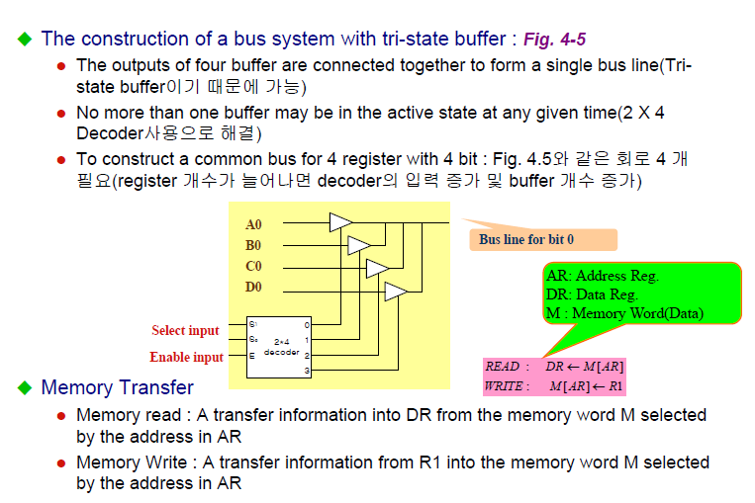
4-3 Bus and Memory Transfer

Slide 14
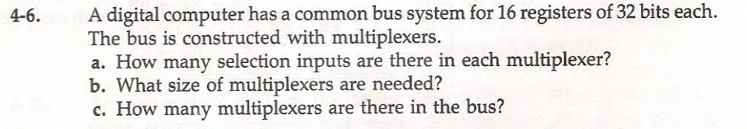
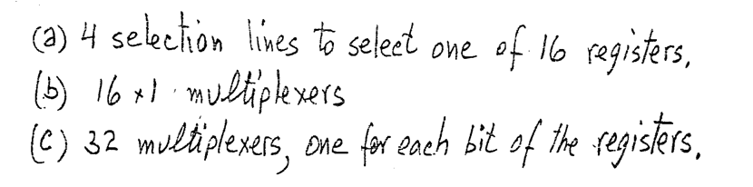
Problem

Slide 15
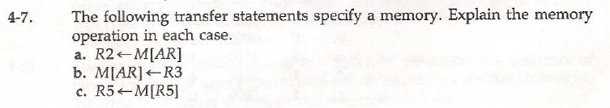
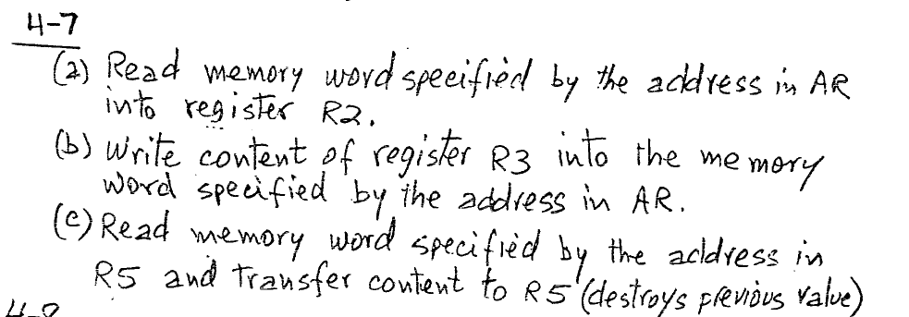
Problem

Slide 16
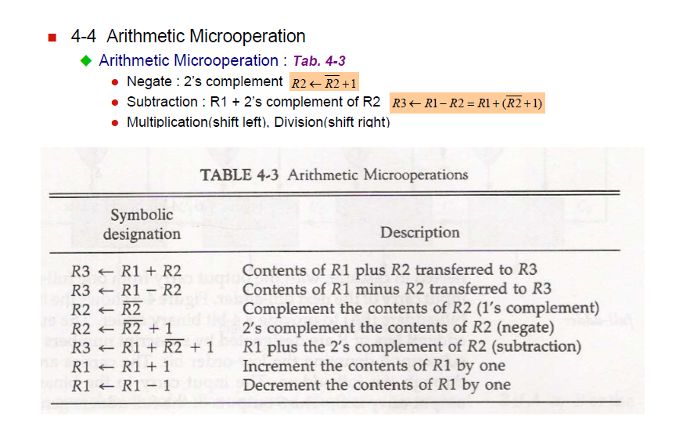
4-4 Arithmetic Microoperations

Slide 17
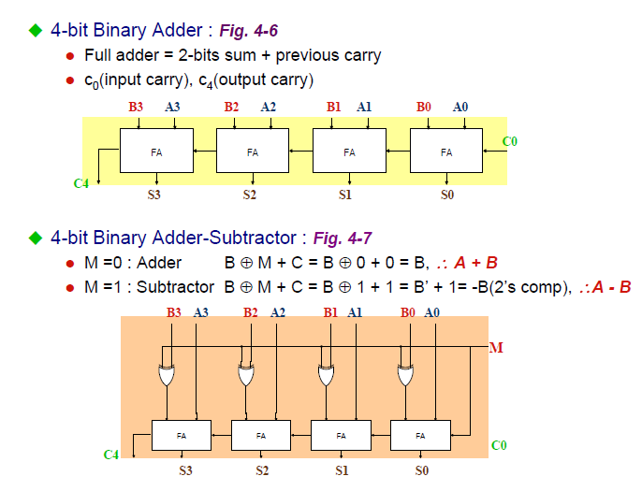
4-4 Arithmetic Microoperations

Slide 18
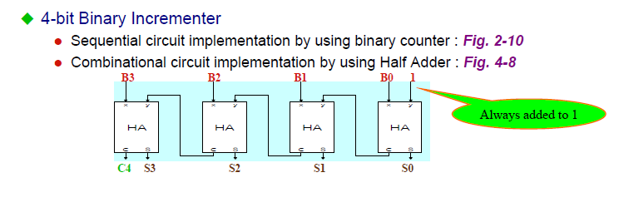
4-4 Arithmetic Microoperations

Slide 19
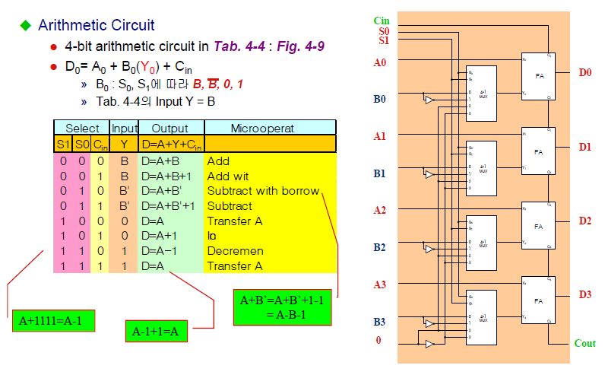
4-4 Arithmetic Microoperations

Slide 20
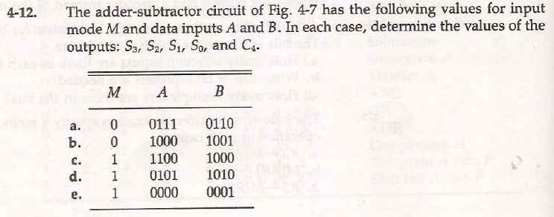
Problem

Slide 21
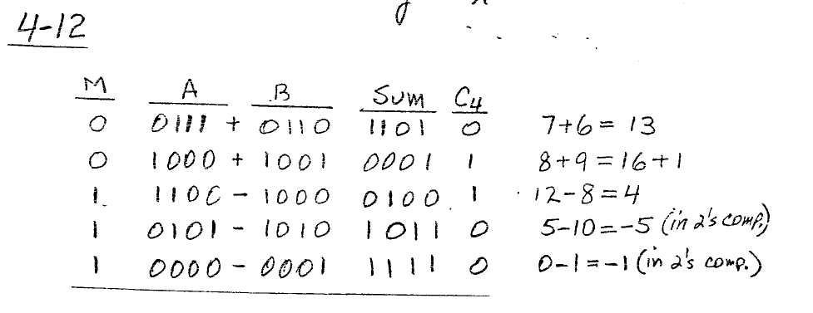
Problem

Slide 22
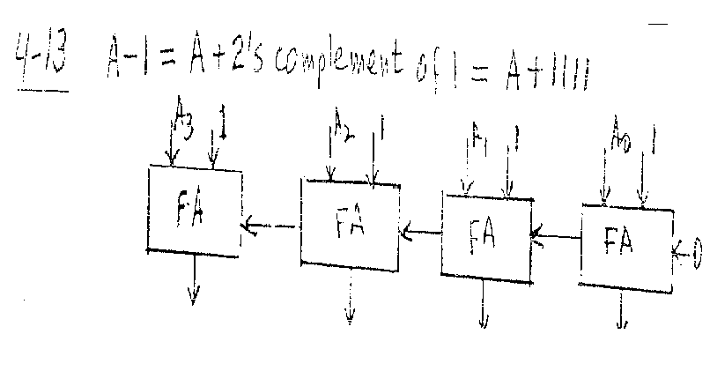
Problem

Slide 23
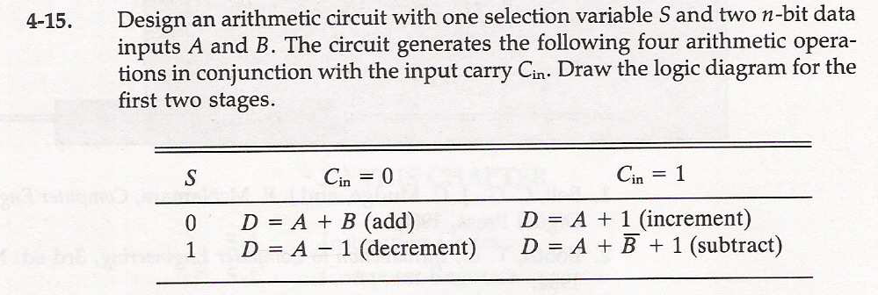
Problem

Slide 24
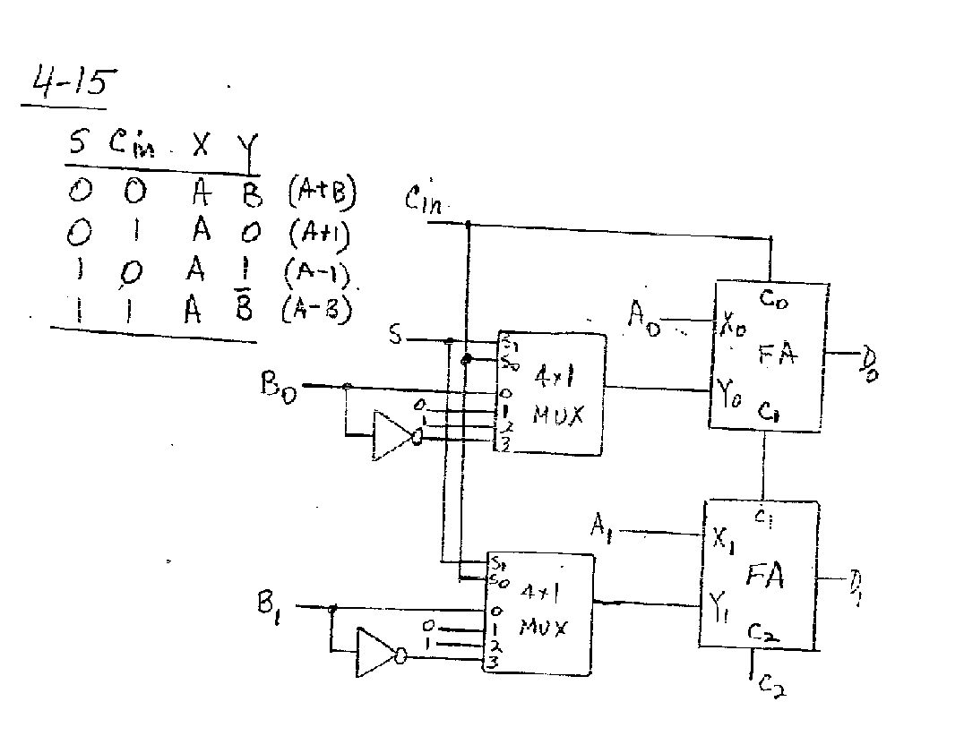
Problem

Slide 25
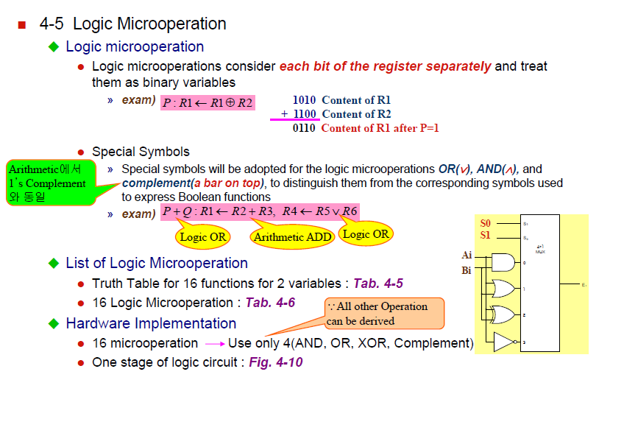
4-5 Logic Microoperations

Slide 26
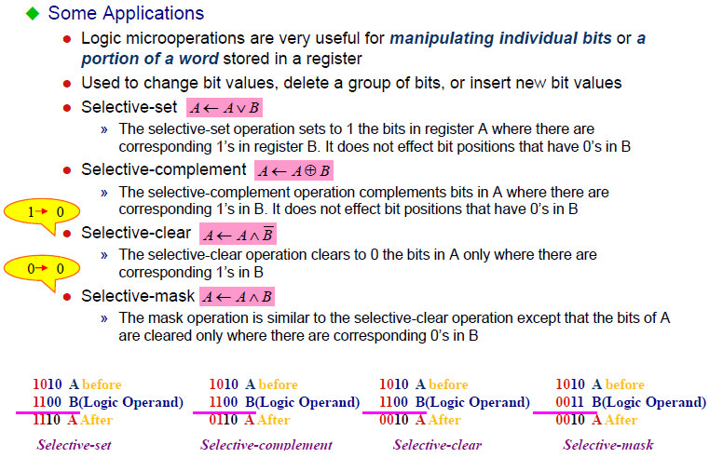
4-5 Logic Microoperations

Slide 27
4-5 Logic Microoperations

Slide 28
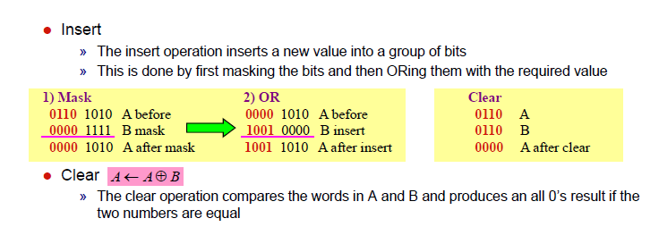
4-5 Logic Microoperations

Slide 29
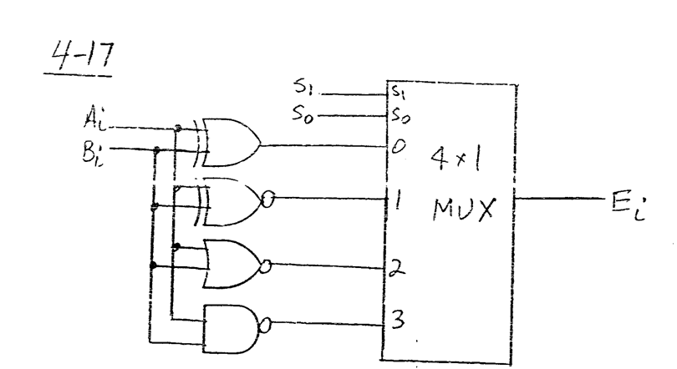
Problem

Slide 30
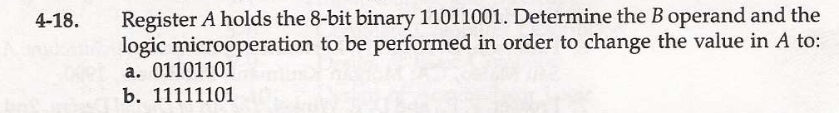
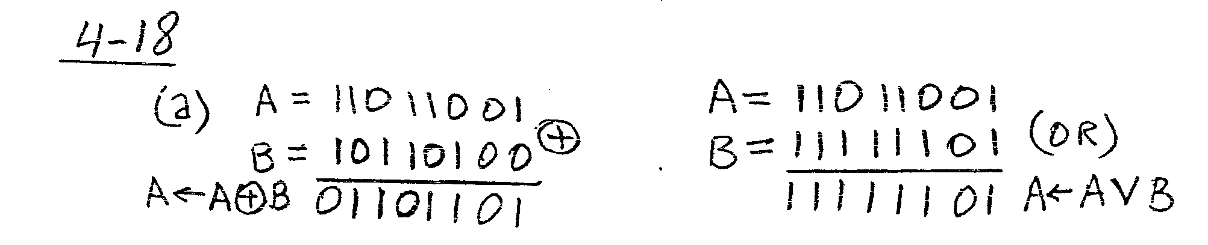
Problem

Slide 31
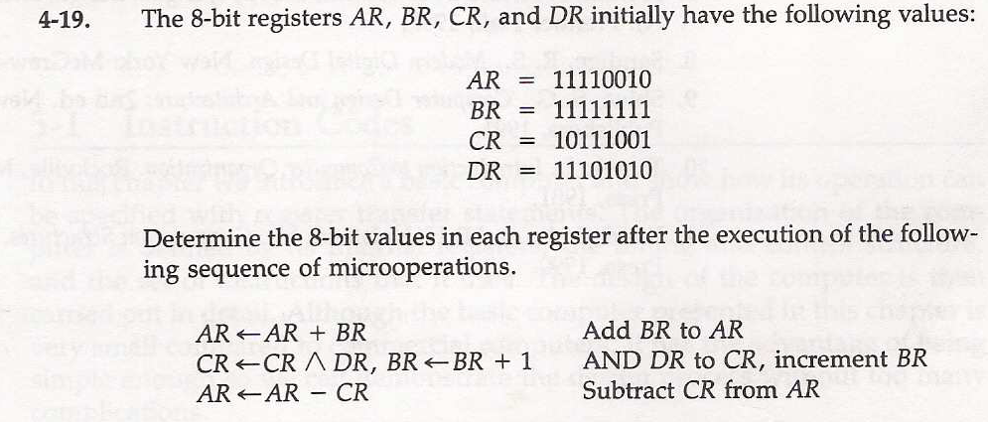
Problem

Slide 32
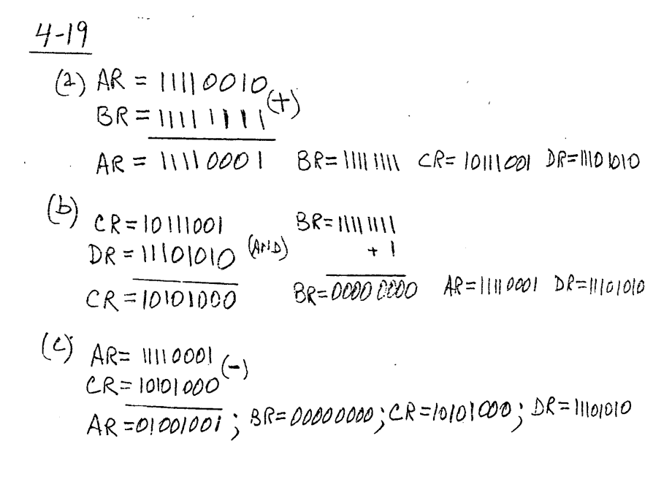
Problem

Slide 33
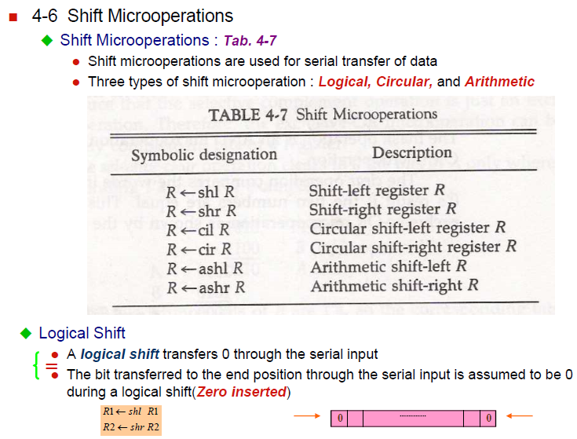
4-6 Shift Microoperations

Slide 34
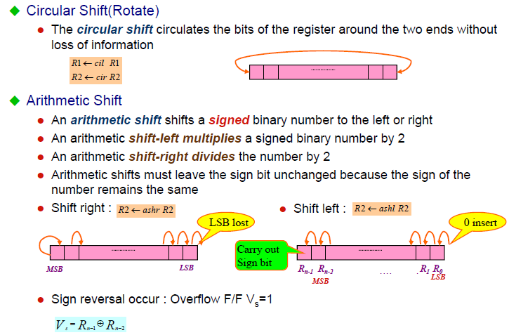
4-6 Shift Microoperations

Slide 35
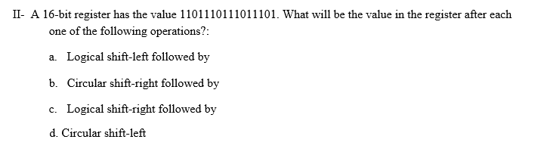
Problem

Slide 36
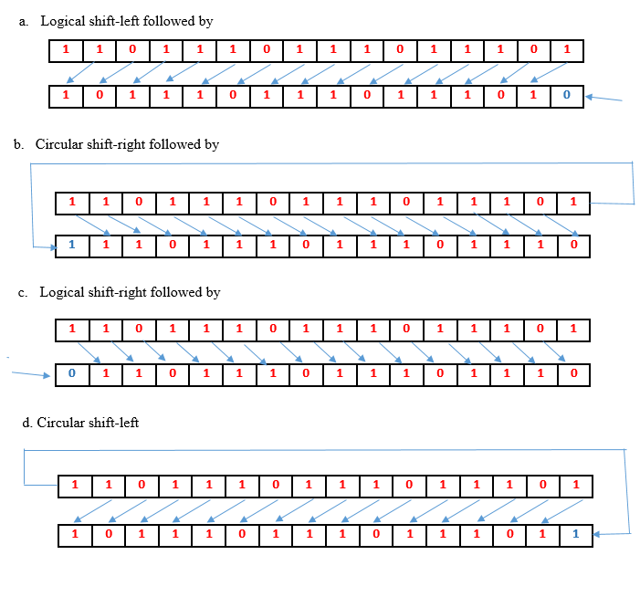
Problem

Slide 37
4-7 Arithmetic Logic Shift Unit

Slide 38
Thanks

